Slide 1

Access Token
Presented By: Sam Pearlman, Jordan Clayton, Guy Krishen

Slide 2
Objective
Create an NFT collection for various events which can be used as a ticket.
These NFT's would be exchangeable during and after the event and become collectibles through the tier system.
The token supply for each tier will be based on the limits set by the event that is being held.

Slide 3
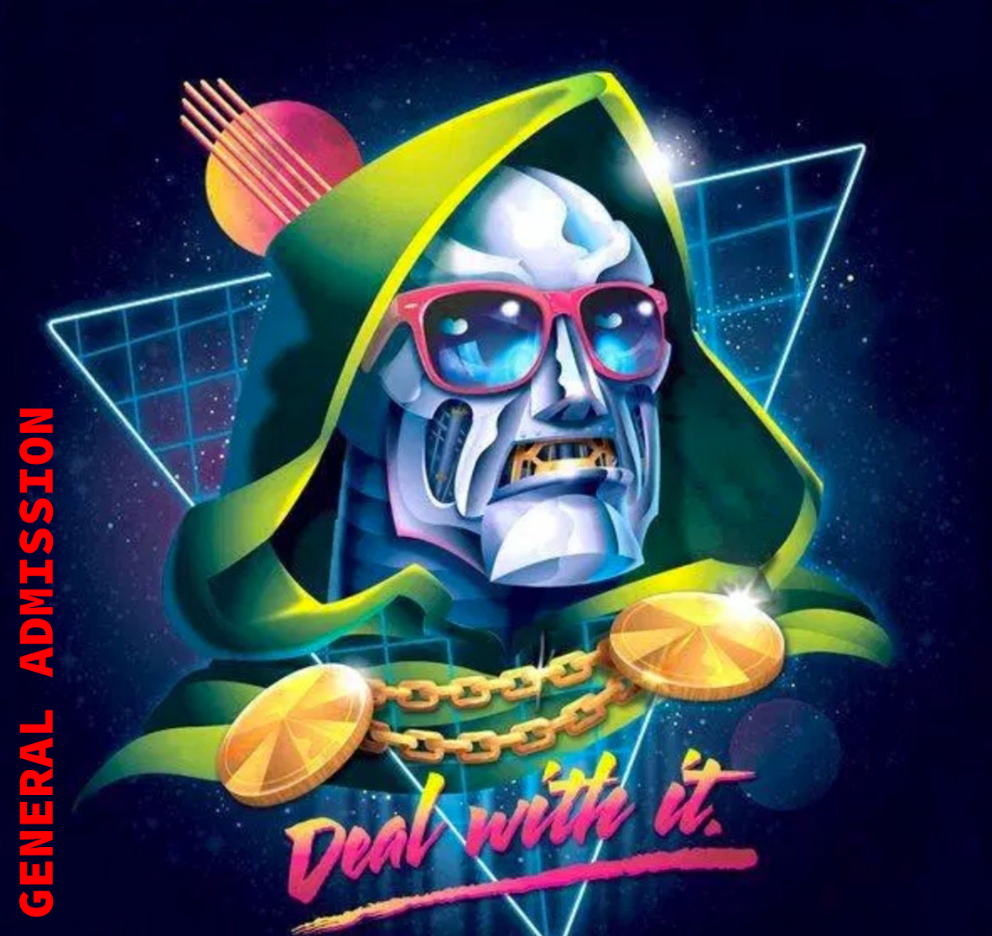
Tier 1: General Admission
This token is readily available and easily obtained

Slide 4
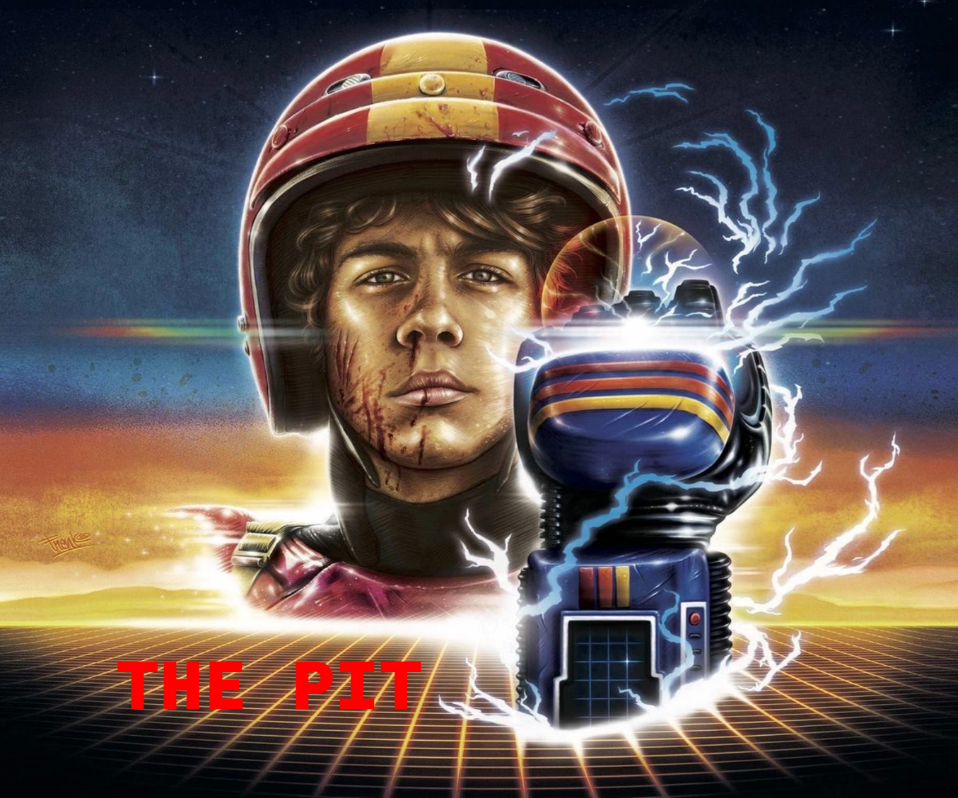
Tier 2: The Pit
This token will be more limited

Slide 5

Tier 3: Back Stage
This token will be extremely rare and difficult to obtain

Slide 6
Token Distribution
Our goal for distribution is to create a Market Place where our collection of Access Tokens is available from various events. The initial token price would be set to the value of the event ticket and can be used to enter the event.
Information such as the event name, event details, and ticket value will be inputed and attached to the NFT.
Ultimately, our end goal is to be able to exchange the tokens if tickets are no longer available, or if the date of the event has passed, using our Market Place.
Alternative options to distribution include the use of pre existing NFT exchanges such as OpenSea and Rarible. Another potential option is the use of "Air Drops".

Slide 7
Air Drops
"Air Drops" are very common and popular occurence in the crypto world and is an easy way to distribute the Access Token purchased if bought through a third party such as TicketMaster, StubHub, SeatGeek, etc.
This would require that the purchaser provide their wallet address so that the token can be sent directly to their wallet.
"Air Drops" are also a easy way to advertise our services through various social media outlets and create hype about the collection that is being released.

Slide 8
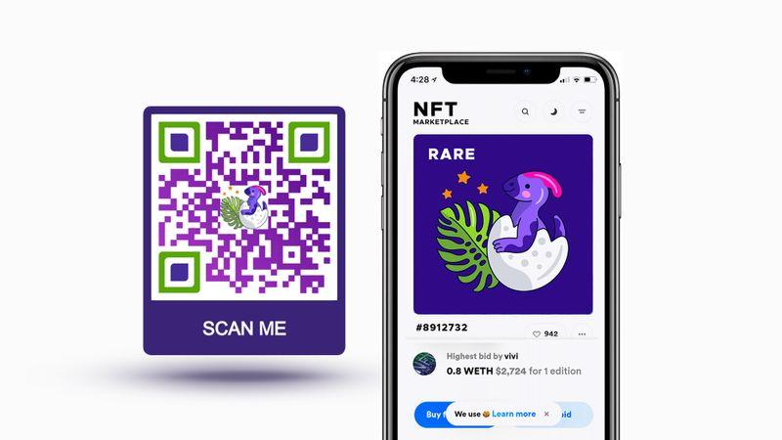
Event Access
To make the our Access Token easier for vendors to allow entrance to the event, we wanted to convert the NFT into a QR code.
https://www.qrcode-tiger.com/qr-code-as-the-gateway-to-the-metaverse

Slide 9
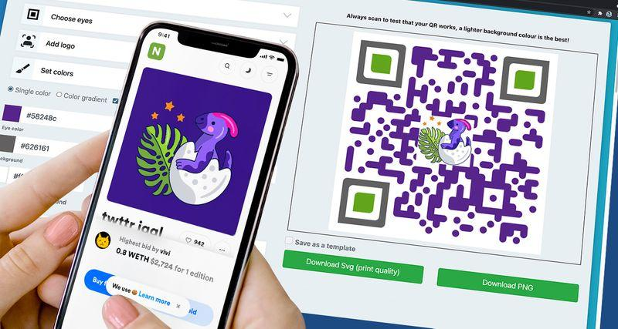
Event Access
This gives the vendor the ability to visibly see the NFT within the the purchasers wallet and helps to validate the authenticity of the NFT. Various other information can also be included within the QR code such as the event details, event name, etc. which is also encoded into the NFT.
https://www.qrcode-tiger.com/qr-code-as-the-gateway-to-the-metaverse

